Slide 1
Some Definite Service Our Diocesan Approach for Parish Support
Autumn 2023

Slide 2
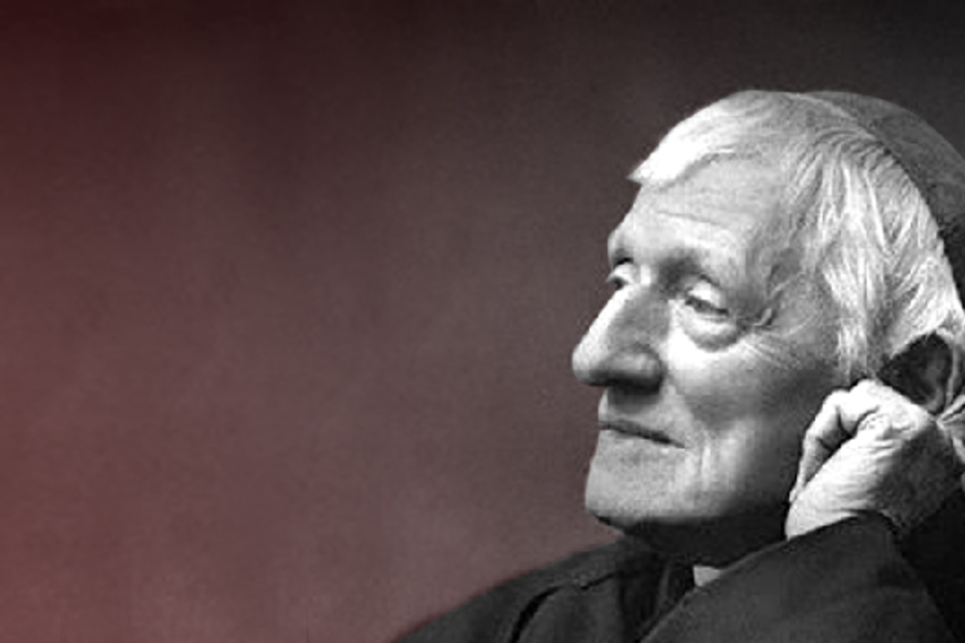
God knows me and calls me by my name.… God has created me to do Him some definite service; He has committed some work to me which He has not committed to another. I have my mission—I never may know it in this life, but I shall be told it in the next.
Somehow I am necessary for His purposes… I have a part in this great work; I am a link in a chain, a bond of connection between persons.

Slide 3
Our Identity as the Church
What kinds of answers do you think people would give to the questions ‘What is the main purpose of the Catholic Church?’ or ‘Why does the Catholic Church exist?’
The Catholic Church itself is unequivocal.
Notes:
I dream of a “missionary option”, that is, a missionary impulse capable of transforming everything, so that the Church’s customs, ways of doing things, times and schedules, language and structures can be suitably channeled for the evangelization of today’s world rather than for her self-preservation. The renewal of structures demanded by pastoral conversion can only be understood in this light: as part of an effort to make them more mission-oriented, to make ordinary pastoral activity on every level more inclusive and open, to inspire in pastoral workers a constant desire to go forth and in this way to elicit a positive response from all those whom Jesus summons to friendship with himself. EG 27

Slide 4
"Each new generation needs new apostles. This means a special mission for you. You young people are the first apostles and evangelisers of the world of youth, assailed today by so many challenges and so much that is threatening (cf. AA 12). Above all, you can be evangelisers, and no one can take your place, where you study, and in your work and your free time. So many of those of your own age do not know Christ, or do not know Him well enough. So you cannot remain silent and indifferent! You must have the courage to speak about Christ, to bear witness to your faith through a life-style inspired by the Gospel. St Paul wrote: ‘Woe to me if I do not preach the Gospel!’ (1 Cor 9:16). The harvest is great indeed for evangelisation and so many workers are needed. Christ trusts you and counts on your collaboration.”
Pope John Paul II (WYD IV – Santiago de Compostela 1989)
Notes:
MESSAGE OF THE HOLY FATHER JOHN PAUL II TO THE YOUTH OF THE WORLD ON THE OCCASION OF THE IV WORLD YOUTH DAY (SANTIAGO DE COMPOSTELA, AUGUST 1989)

Slide 5
Vision Agency for Evangelisation and Catechesis
Helping missionary parishes to form missionary disciples.
Like the Archbishop and the Holy Father, we dream of a ‘missionary option’.
Notes:
I dream of a “missionary option”, that is, a missionary impulse capable of transforming everything, so that the Church’s customs, ways of doing things, times and schedules, language and structures can be suitably channeled for the evangelization of today’s world rather than for her self-preservation. The renewal of structures demanded by pastoral conversion can only be understood in this light: as part of an effort to make them more mission-oriented, to make ordinary pastoral activity on every level more inclusive and open, to inspire in pastoral workers a constant desire to go forth and in this way to elicit a positive response from all those whom Jesus summons to friendship with himself. EG 27

Slide 6
Some Definite Service is the diocesan-wide approach for parish growth in Evangelisation, Catechesis, and Formation supported through local people, plans, and prayer.
Notes:
SDS Summary paragraph

Slide 7
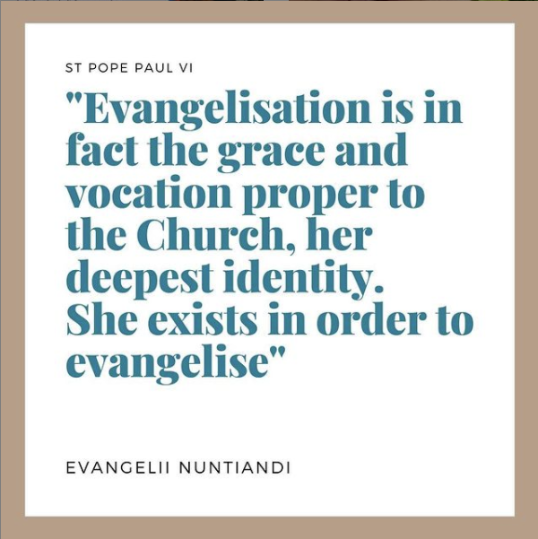
Three areas Evangelisation, Catechesis, and Formation
Notes:
NAME THE AGENCY TEAM

Slide 8
Key Principles Some Definite Service
Focus on the ‘grassroots’ in parishes, universal support
Motivated by attention to people through programmes
Local initiative, subsidiarity and solidarity
Notes:
I dream of a “missionary option”, that is, a missionary impulse capable of transforming everything, so that the Church’s customs, ways of doing things, times and schedules, language and structures can be suitably channeled for the evangelization of today’s world rather than for her self-preservation. The renewal of structures demanded by pastoral conversion can only be understood in this light: as part of an effort to make them more mission-oriented, to make ordinary pastoral activity on every level more inclusive and open, to inspire in pastoral workers a constant desire to go forth and in this way to elicit a positive response from all those whom Jesus summons to friendship with himself. EG 27

Slide 9
Mission Agency for Evangelisation and Catechesis
Support parishes in their journey from maintenance to mission through Some Definite Service.
Facilitate the development of effective parish plans.
Create a culture of consistent, grassroots support to parishes in the form of a volunteer missionary network.
Produce resources and courses as well as, highlighting good practice in our parishes.

Slide 10
People Volunteer Missionary Network
Each of the three areas, Evangelisation, Catechesis, and Adult Formation, will have the same basic structure with cooperation between areas at every stage.
Advisors
Deanery Mentors
Parish Leads
Engaged parishioners
3 posts [3]
20 Mentors per area [60]
175 Leads per area [525]
Hundreds of people engaged in support
Notes:
23 DMs commissioned, 4 in the pipeline (Discovery, interviewed).
PARISH LEADS: appointed by the parish priest

Slide 11
Archbishop John Wilson
Episcopal Vicar | Diocesan Advisor | Other Advisors and Director
Dean | Deanery Mentor | Other Mentors
Parish Priest | Parish Lead | Other Leads
 | Parish Volunteers & Teams
The ‘ones’ – those who don’t know Jesus or don’t know him well enough
Notes:
Highlight Support and Clergy involvement.
Highlight raising up of lay leaders
Highlight a situation where no one is left neglected or unsupported;
A situation where priorities and wisdom is shared in ‘real time’ rather than responses dreamed up to problems that don’t exist or are the fruit of a random preference.
The ‘ones’ – those to be evangelised, catechised, formed.

Slide 12
Plan: Session Elements
Gather your group; size of the group is of less importance than interest and an ability to maturely and effectively contribute.
Start with prayer; we recommend a period of Lectio Divina (using John 1:35-39 or a passage pertaining to the areas of focus under consideration).
Follow the pattern laid out in section 4 of the Parish Plan document, for each area of focus.
Commit to paper your thoughts (and submit via the online form).

Slide 13
Plan: Process in Outline
Developing a VISION (what do we want and what is the Lord’s will for our parish?)
Understanding the REALITY (what is our current context and capability?)
Creating a PLAN (what can we concretely undertake in the three areas?)
Notes:
What is the Parish Plan?
Every parish has a vision of becoming a missionary parish. We want more people to meet the Lord Jesus, to grow in knowledge and love of him, and then to go out and call others to Faith. This vision comes to life through concrete events. Maybe you have a vision of reconnecting with parishioners who have not yet returned to Mass? Maybe you would like to establish a post confirmation group for the young adults in your parish? Maybe you are concerned that you need new Catechists but don’t know how they can be formed? Whatever your parish vision, the parish plan is your plan for making that vision a reality.
Why are we making a plan?
Every parish is unique and our needs are all different. In making the plan, you will focus on the three key areas of Evangelisation, Catechesis and Formation and in each of these areas, you will be asking three key questions.
What do we want? This is the Parish Vision.
What is happening at the moment? This is the Parish Picture.
What do we need to do? This is the Parish Plan.
In the process of creating the Parish Plan, you will able to affirm what you are doing well, assess the areas that need attention, and advance your plans for further growth. You have already done a lot of this work in the Synodal questionnaire so you might find some of the information you gathered previously, helpful for this stage. Think of the process as carrying out a Parish MOT.
How do we make the plan?
Over the course of 4 meetings with key people, you will be introduced to Some Definite Service, and then to the three stages for the creation of the Plan. Parish Vision, Picture, and Plan. We will provide questions and resources to help you, advice and information on making Grant Applications, and put you in touch with key people to help you.
Who might be involved in the creation of our parish plan?
You are best placed to know who the key people are in your parish. The Parish Leads in each of the three areas will be important, as will the Deanery Mentors, but we will provide resources for you to include as many people as you need to, as you develop the Parish Plan.
How will the plan be useful to us in our parish?
Once you have created the Plan, you will have a roadmap for implementing your parish vision in each of the three areas. The plan will include stages for looking at how implementation is going, key milestones for further conversations and the possibility of connecting with other parishes across the diocese. We hope that by undertaking this process, you will be able to establish one new event in the areas of Evangelisation, Catechesis and Formation, over the next 12 months, in your parish.

Slide 16
"The task of evangelising all people constitutes the essential mission of the Church. It is a task and mission which the vast and profound changes of present-day society make all the more urgent. Evangelising is in fact the grace and vocation proper to the Church, her deepest identity. She exists in order to evangelise."
Evangelii Nuntiandi 14
Notes:
No such thing as vocational unemployment if you are a Catholic. If you’ve been baptised, you are granted access to gifts and graces. Somebody out there is waiting for what what you have been given to give! In God’s providence you are the one that will help them, it is important that you say yes.

Slide 17
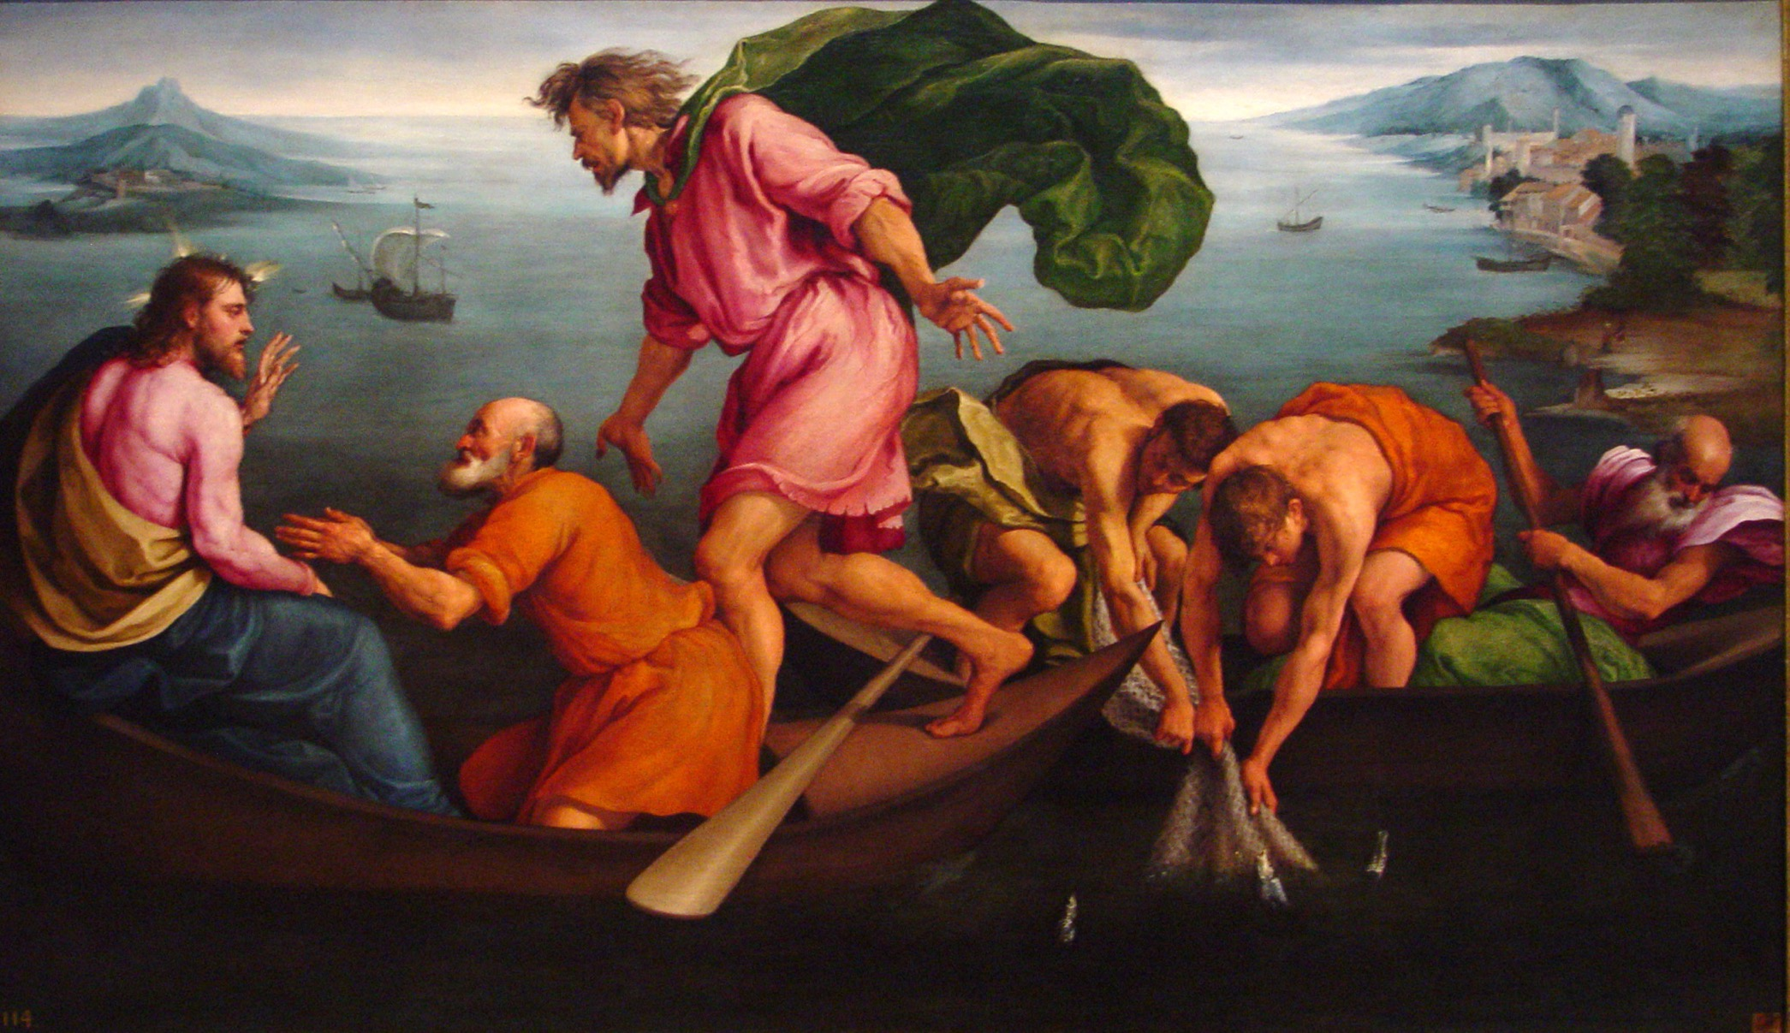
The Miraculous Draught of Fishes
by Jacopo Bassano (1545)
Wikimedia Commons

